Slide 1
Fondazione Biotecnopolo di Siena
The Italian initiative for Pandemic Preparedness and Response
Rino Rappuoli
US - Italy Joint Commission Meeting
Rome January 26th 2023

Slide 2
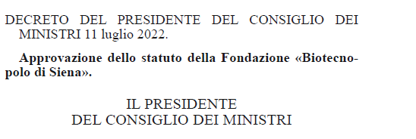
A Decree to create a National Center for Pandemic Preparedness (CNAP)
Funded by the Italian Goverment
was Published on August 26th 2022

Slide 3
CNAP will be located in Siena a city with a long vaccine development experience
Siena is the only place in Italy, and one of the few in Europe, where vaccines and sera have been discovered, developed, manufactured, and commercialized for more than a century
1904 Sclavo: Anthrax serum
1950’s diphtheria and tetanus vaccines
1960 Albert Sabin spends months in Siena to develop oral polio
1992 Chiron First recombinant acellular pertussis vaccine (NIH efficacy trial done in Italy)
1992 first conjugate vaccine against meningococcus C
1997 first adjuvanted vaccine against influenza
2000 first vaccine discovered from the genomic sequence (Reverse Vaccinology)
2006 Novartis creates the Novartis Vaccines Instituite for Global Health (NVGH, today GVGH)
2011 tetravalent vaccine against meningococcus ACYW licensed
2013 first vaccine against meningococcus B licensed
2015 GSK Men B vaccination implemented in United Kingdom
2020 typhoid conjugate vaccine WHO prequalification (GVGH)
2020 TLS Discovery and clinical trials with a human monoclonal against Covid-19
Vismederi tests Covid-19 clinical samples of Curevac, BioNTech, Clover, Vaxxinity, Daiichi Sankyo ….
Today an ecosystem with:
>1200 people working on vaccines and related R&D activities
~ 600 GSK vaccines R&D
>60 GVGH (GSK Vaccines Institute for Global Health)
>600 Toscana Life Sciences (TLS has 80 employees and 500 people working for 50 start-ups)
~ 1900 people working on Vaccine Manufacturing

Slide 4
CNAP Vision
A National Center, funded by the Italian Government up to the end of 2026
The ambition to be a resource for Europe and for the world
To be part of a global network of Institutes preparing the world for new pandemics (collaborate with CEPI, HERA, NIH, CARBX, BMGF, Wellcome Trust, Pasteur Network, etc..)
Focus on Vaccines and Monoclonal Antibodies
Target: Emerging Viruses and Antibiotic Resistant bacteria (AMR)
Discovery, GMP up to phase 2B, for emergency approval

Slide 5
From Discovery to phase 2b
Sustainable vaccine development model
Filing, registration and commercialization
Clinical Dev
Tech transfer
Clinical Development
Pre-Clinical Development
Research
Identify Antigens
Produce Antigens
Pre-clinical Testing
Phase I
Phase II
Proof of Concept/EUA
Phase III
Filing & Registration
Post-marketing surveillance
BioTecnopolo
Partnerships

Slide 6
Focus of CNAP

Slide 7
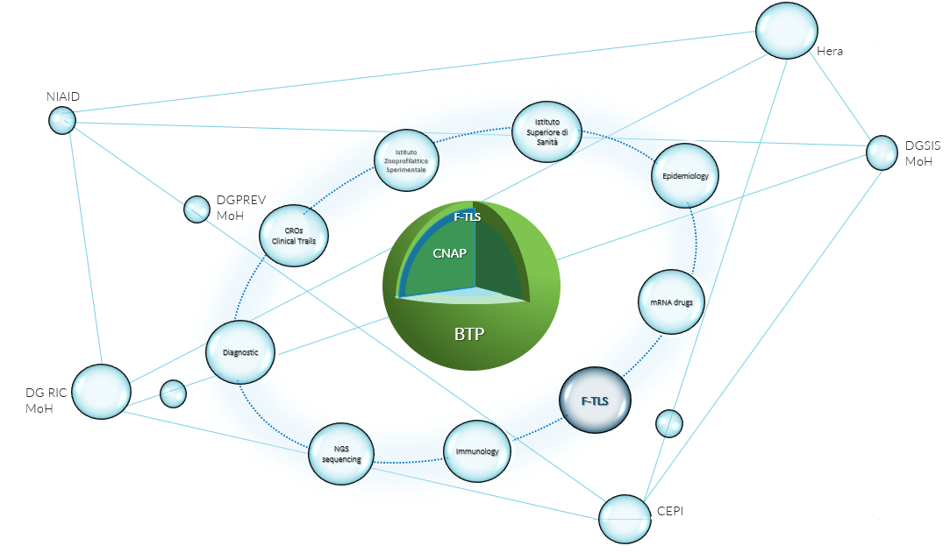
Part of the Global system
with the ambition to become a leading center

Slide 8
Thank you for your attention

